Slide 1
No Quiz!
Interpreting and Explaining Algorithms

Slide 2
An explanable AI by any other name...
Interpretable
Intelligible
Interogatable
Understandable

Slide 3
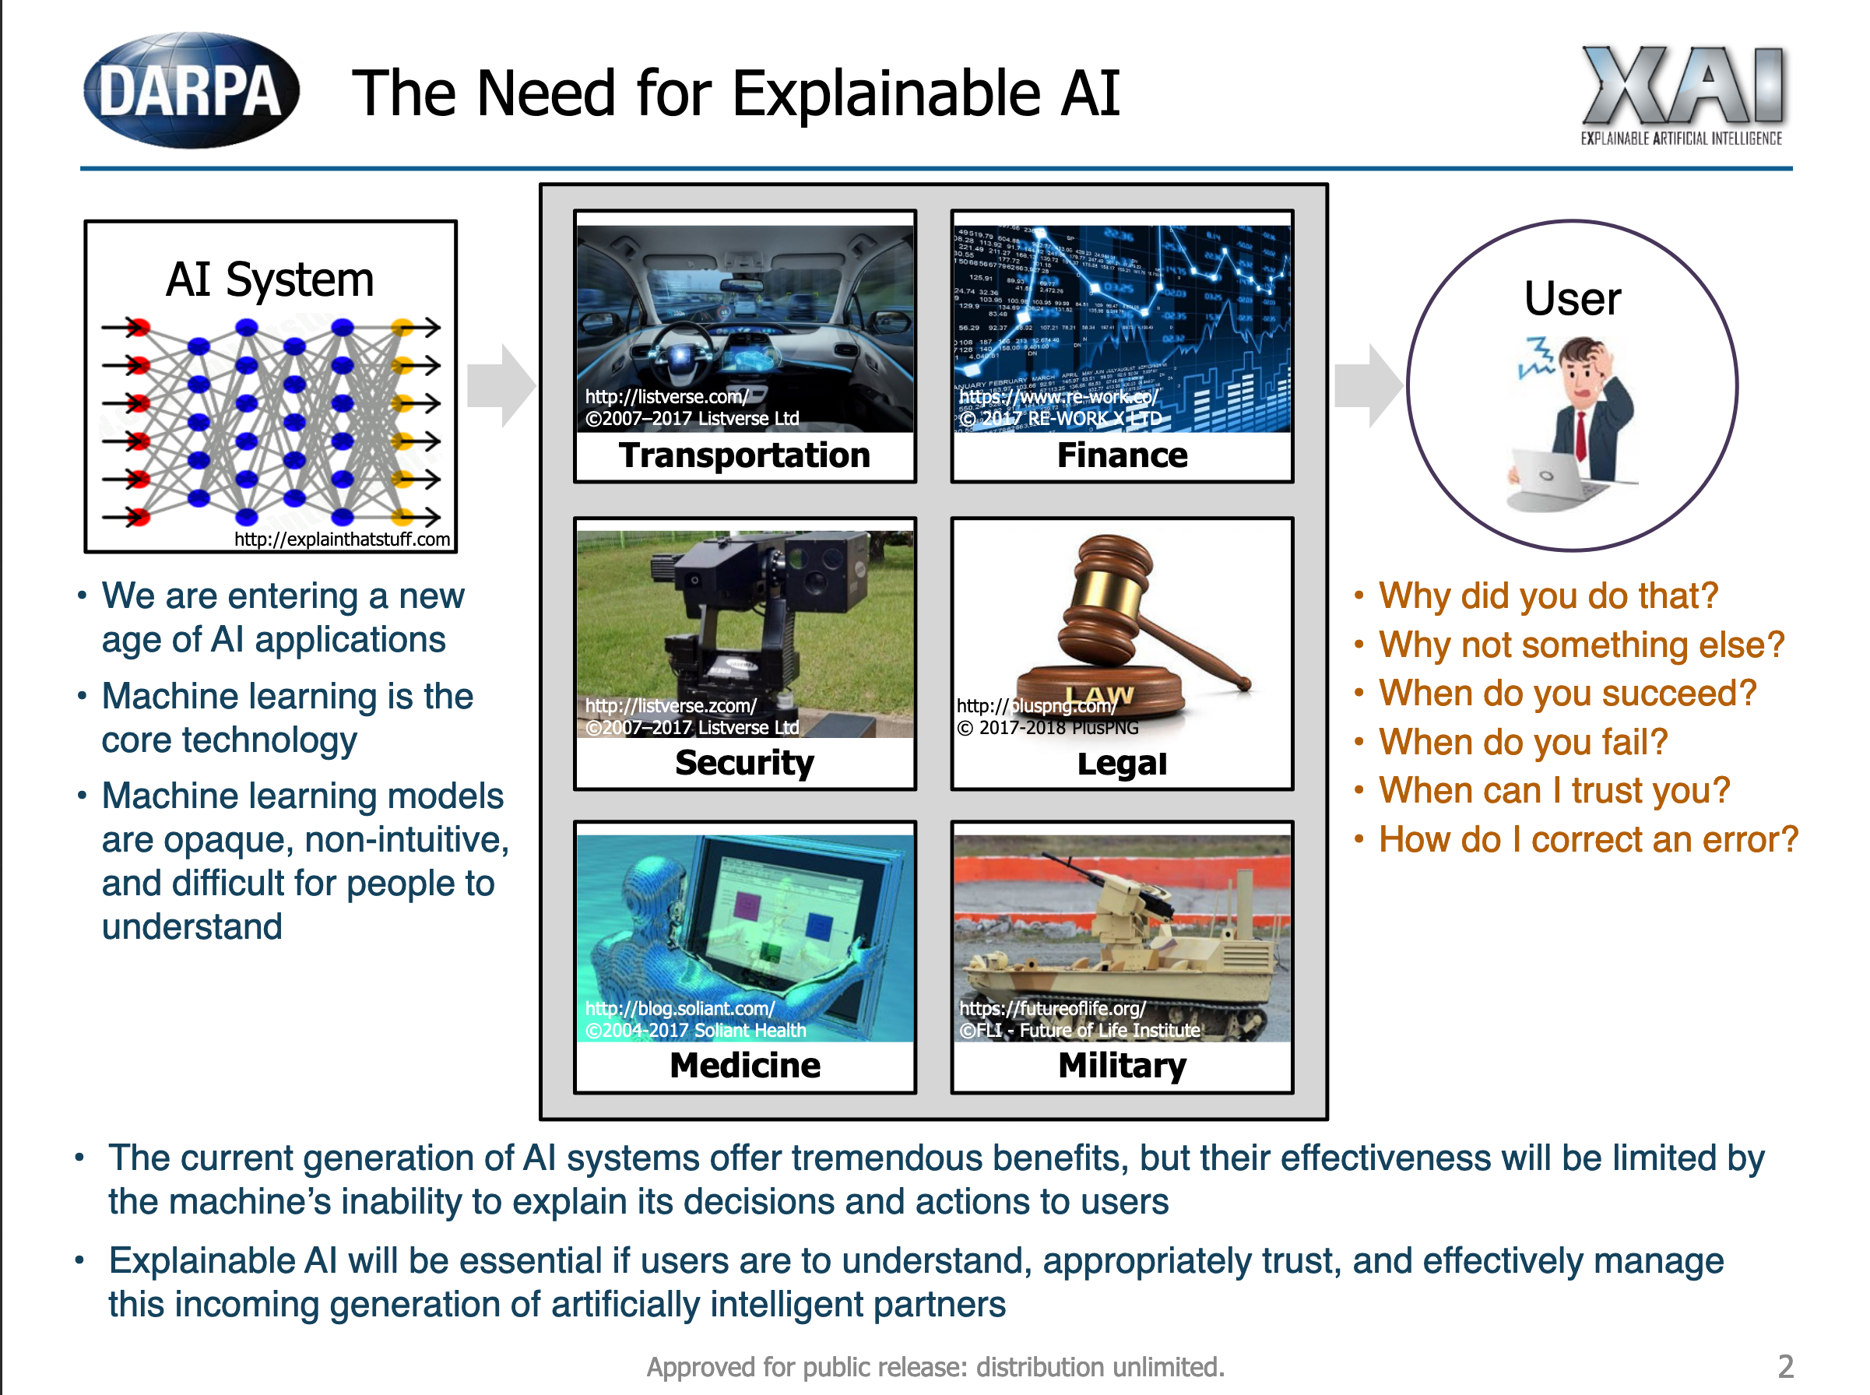
Notes:
https://www.darpa.mil/attachments/XAIProgramUpdate.pdf

Slide 4
Good explanation/bad explanation?

Slide 5
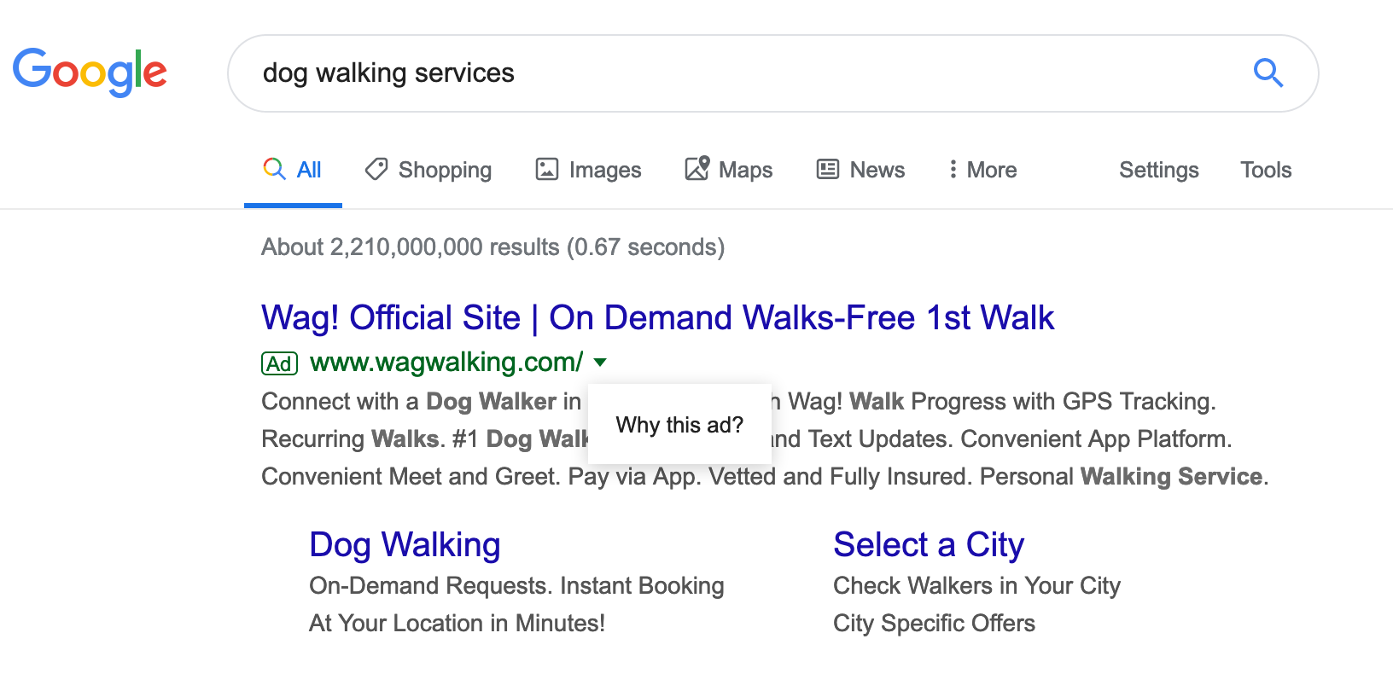
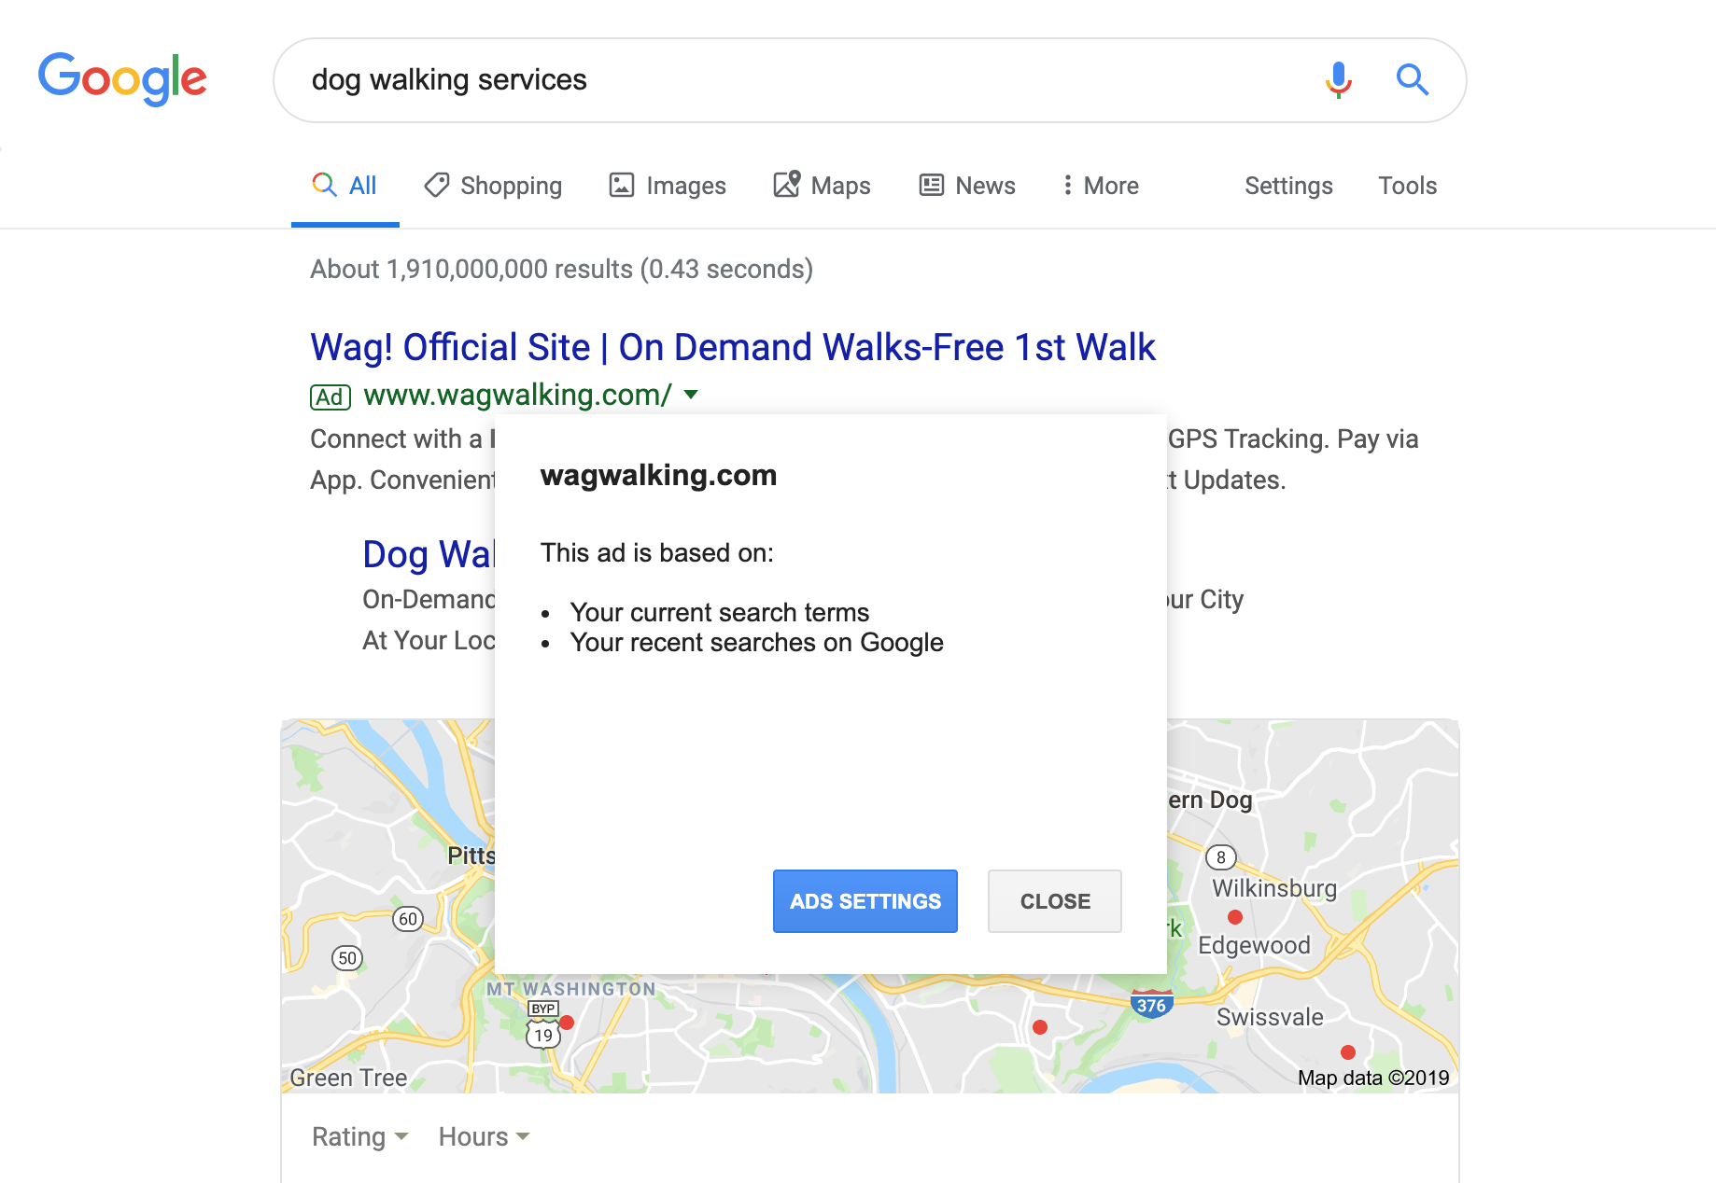
Good explanation/bad explanation?

Slide 6
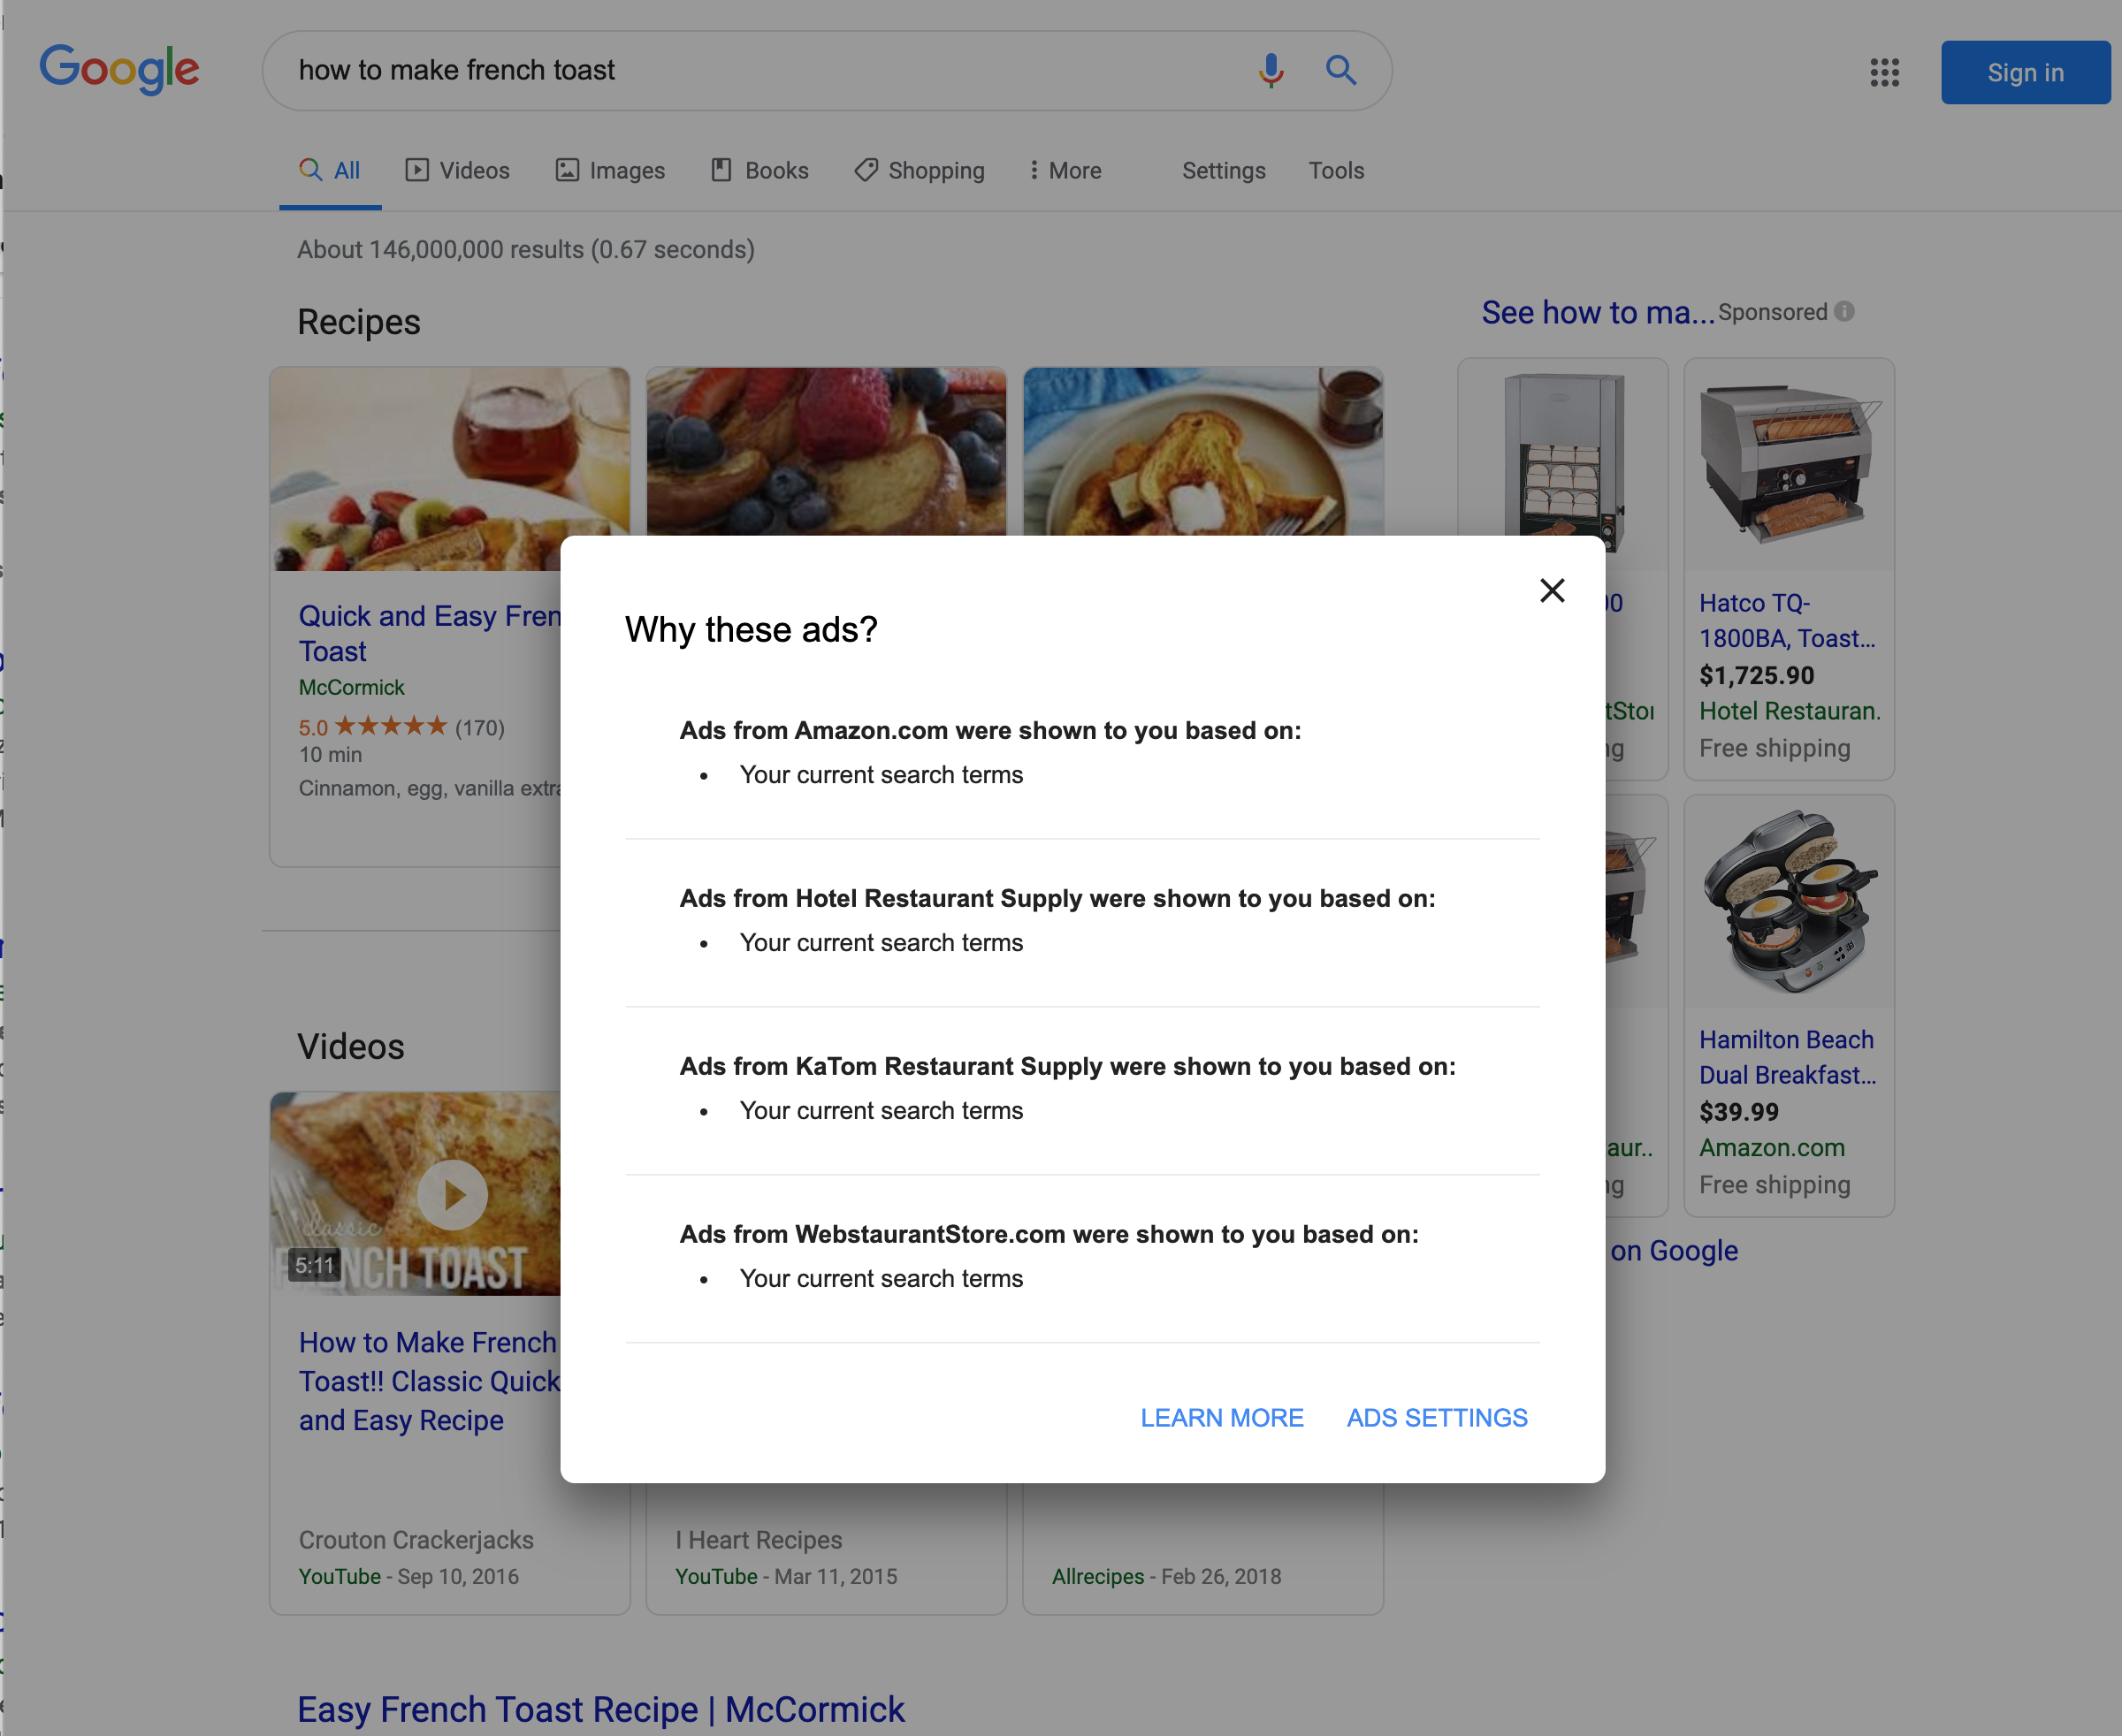
Good explanation/bad explanation?

Slide 7
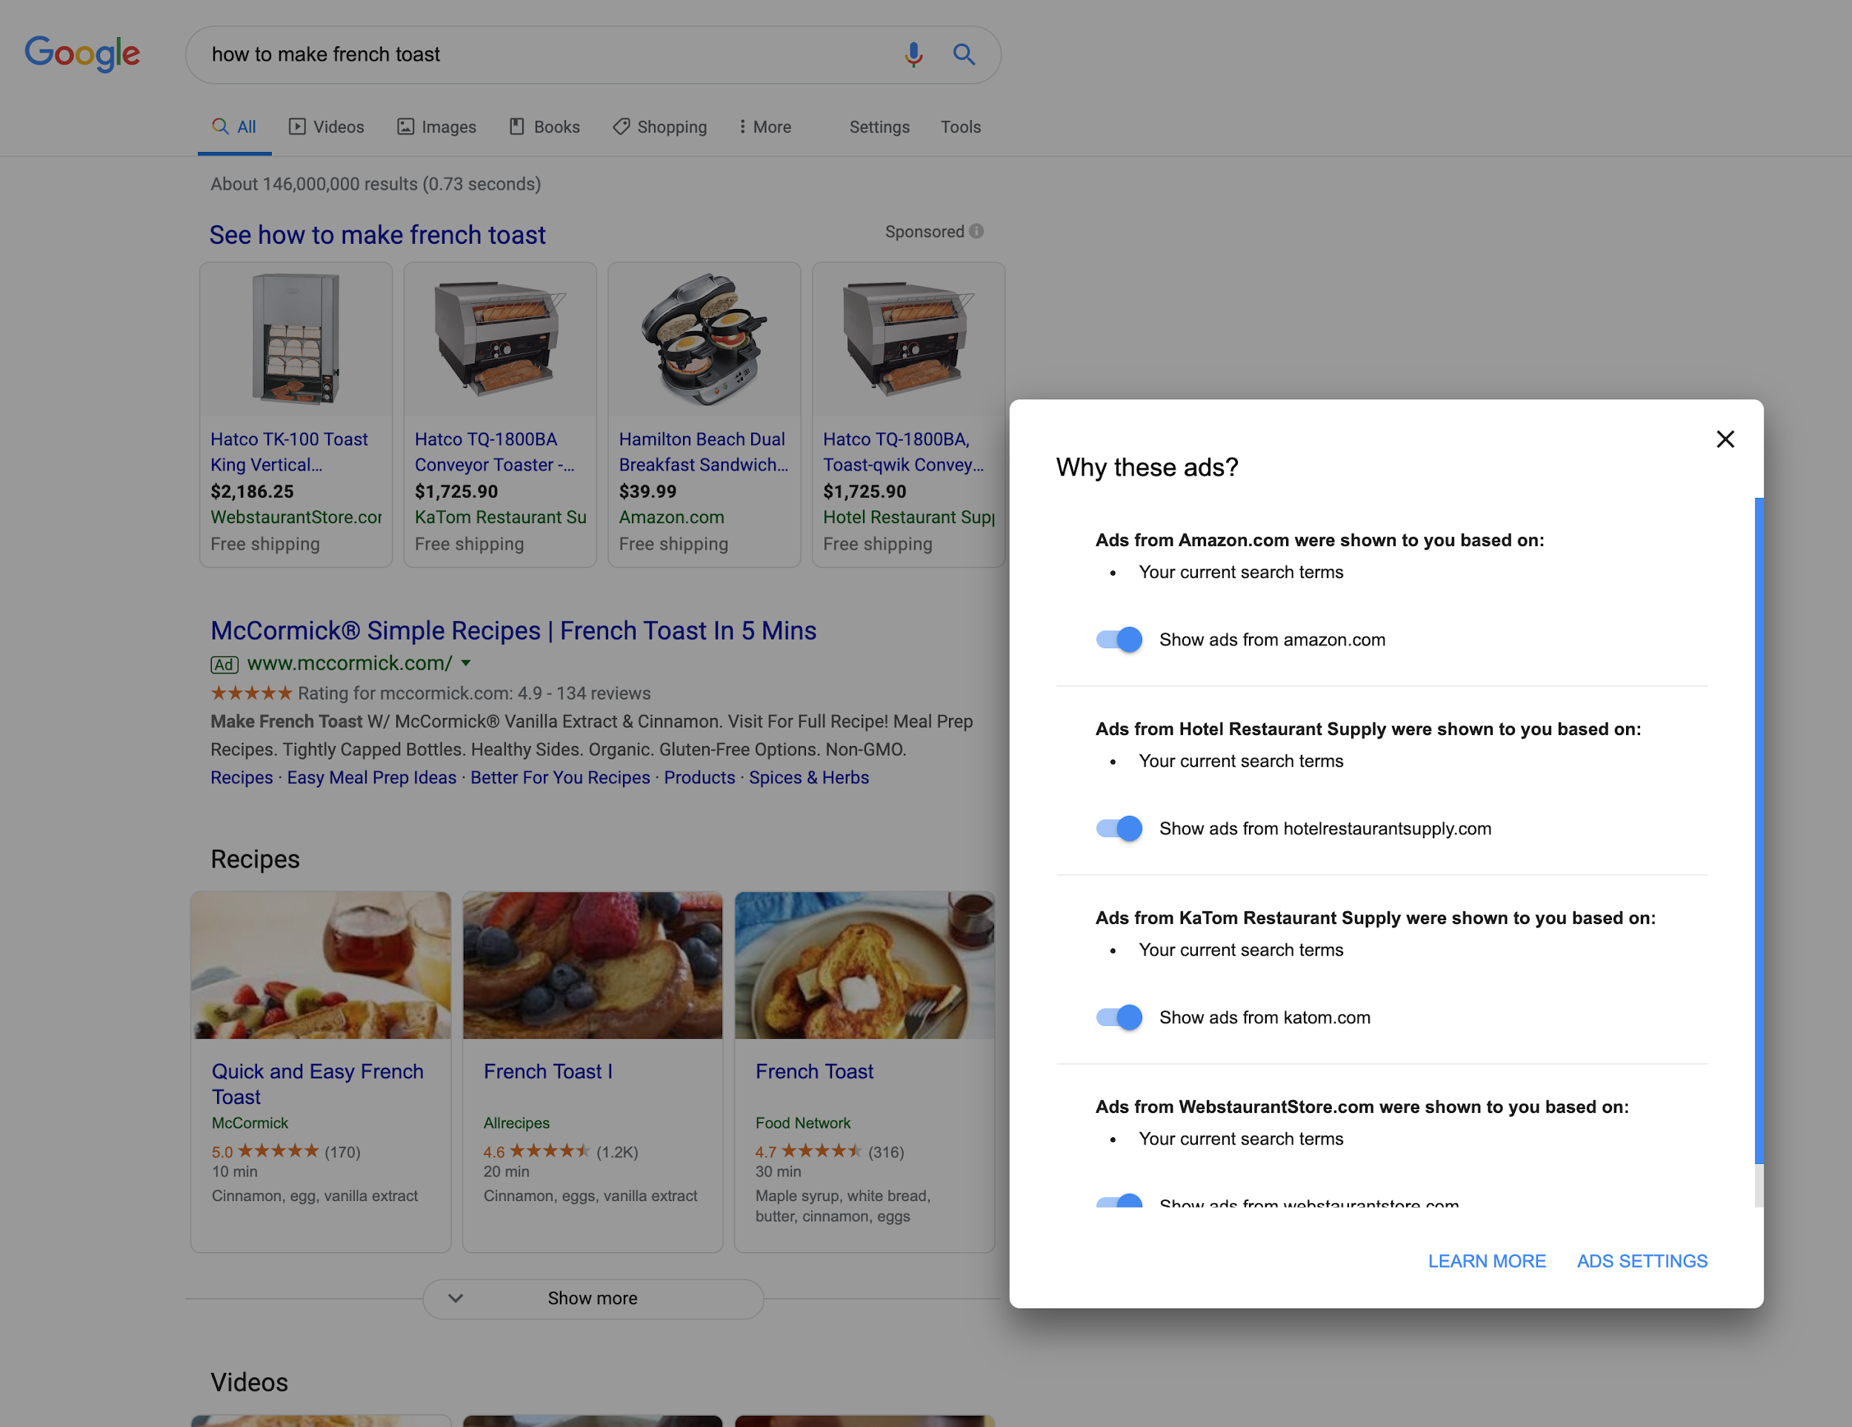
When logged in

Slide 8
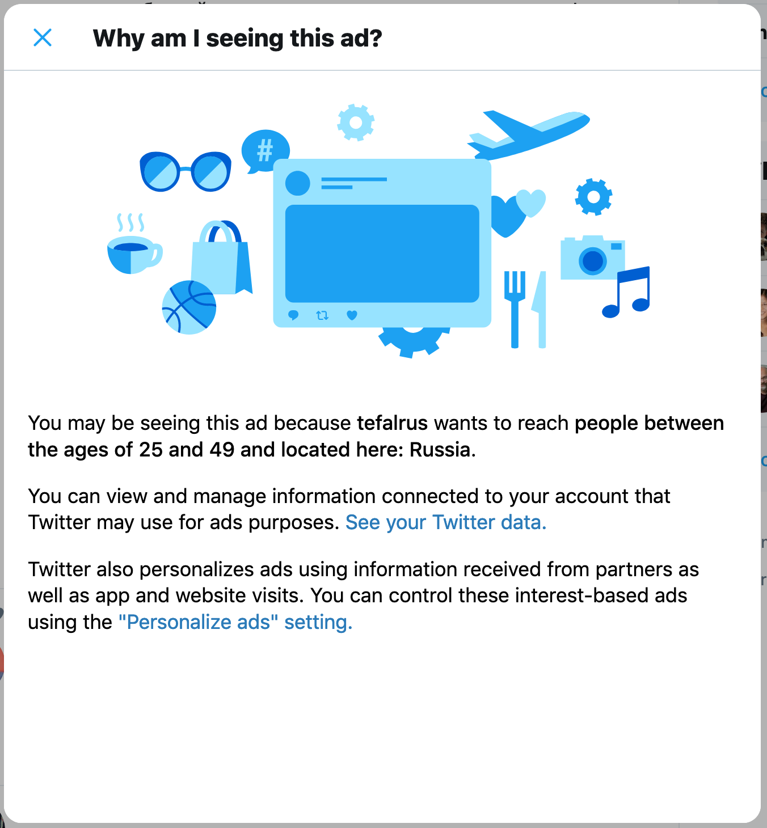
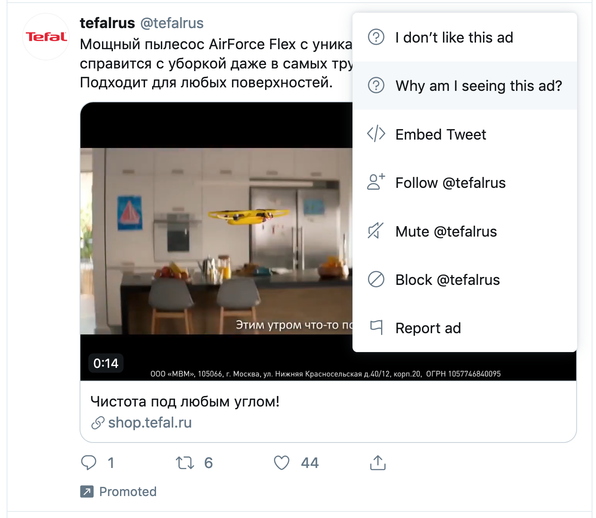

Slide 9
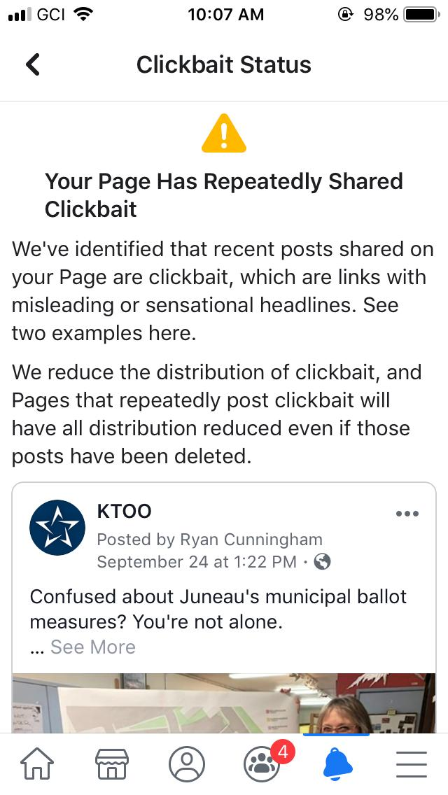
Good explanation/bad explanation?
KTOO is Alaska’s NPR station
Notes:
https://twitter.com/RyCunn/status/1181280901772111874/photo/1

Slide 10
Good explanation/bad explanation?
KTOO is Alaska’s NPR station
A good explanation exposes when the algorithm goes wrong
Notes:
https://twitter.com/RyCunn/status/1181280901772111874/photo/1

Slide 11
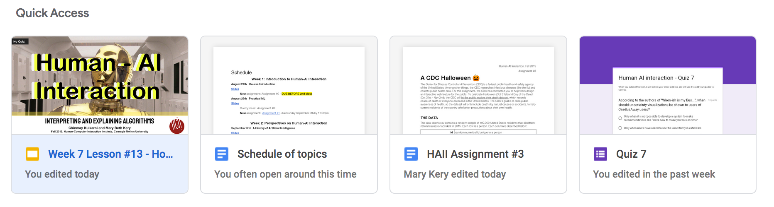
Good explanation/bad explanation

Slide 12
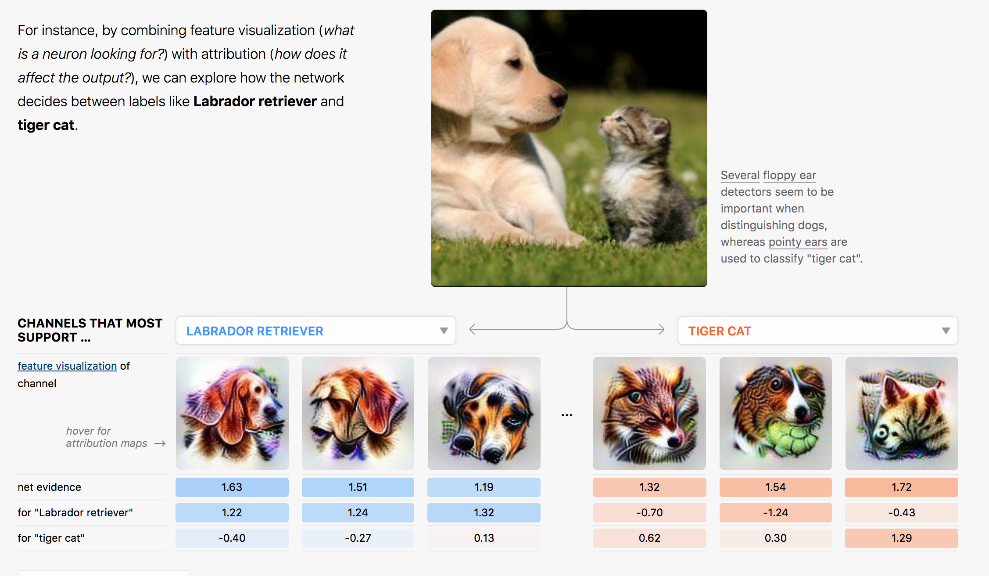
Good explanation/bad explanation
Notes:
From https://distill.pub/2018/building-blocks/

Slide 13
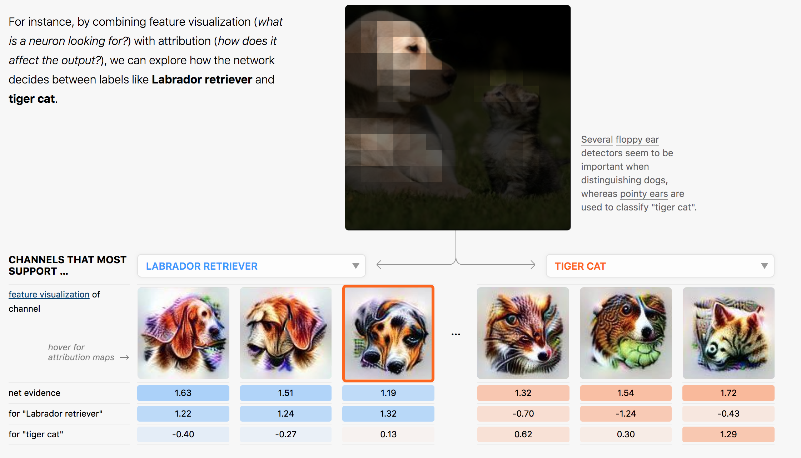
Good explanation/bad explanation

Slide 14
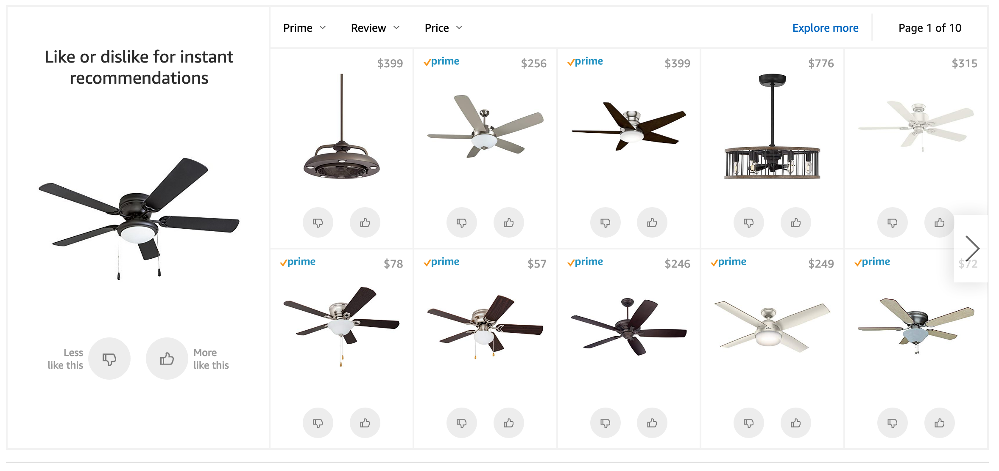
Is this even an explanation?
Why or why not?

Slide 15
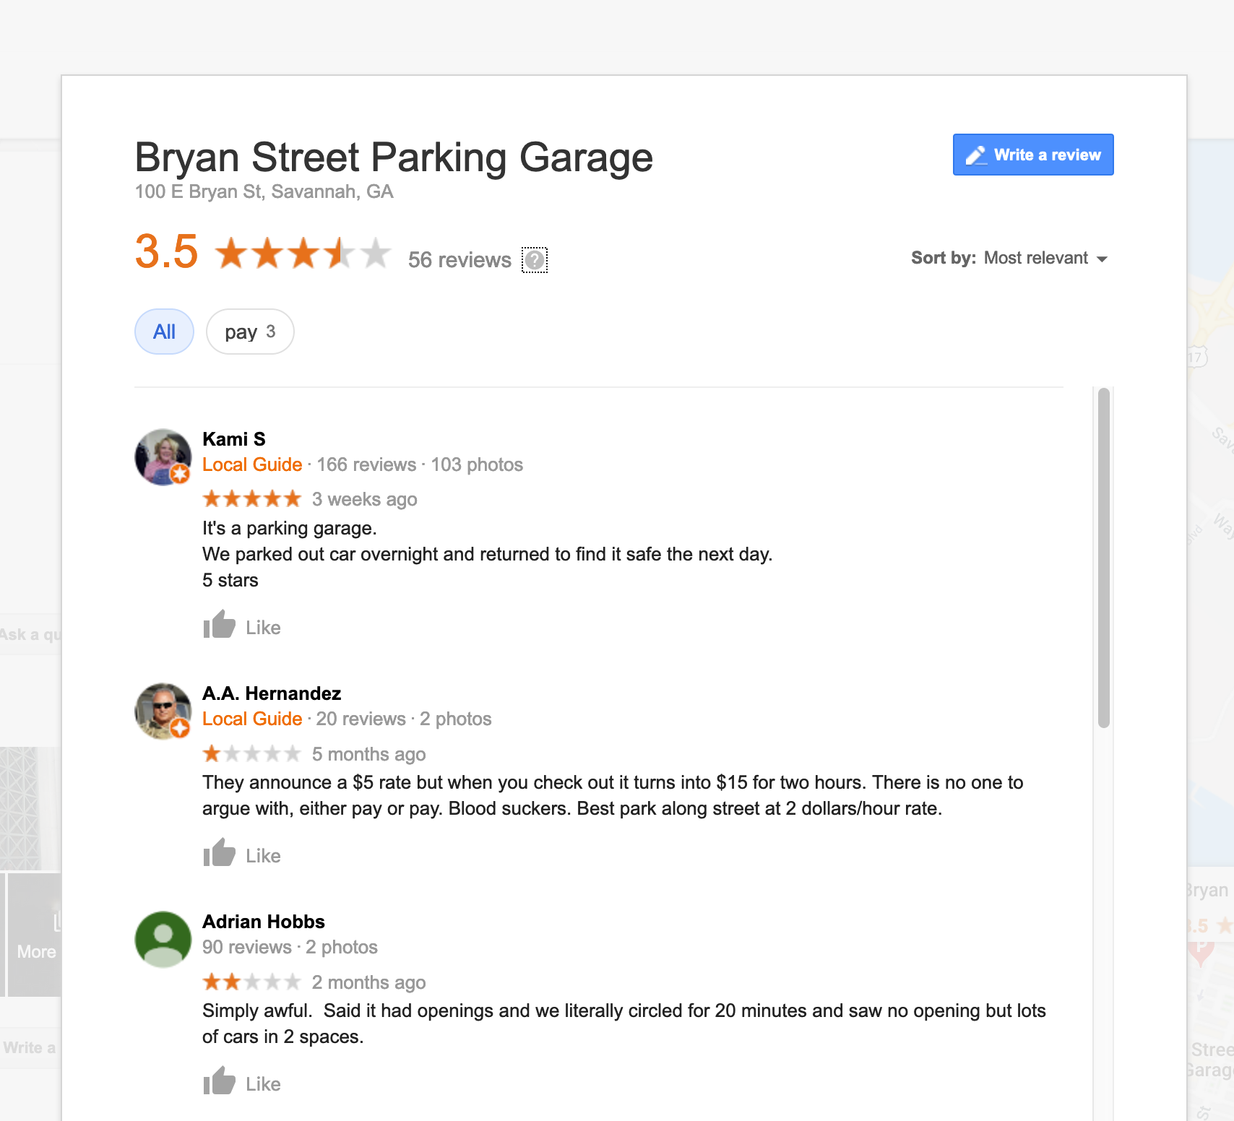
How about this one?

Slide 16
A few takeaways
Good explanations allow you to answer questions:
Why did you do that?
Why not something else?
When do you succeed?
When do you fail?
When can I trust you?
How do I correct an error?
Good explanations help even if the AI you explain isn’t very good
Not all explanations look like explanations

Slide 17
You try it
This is a simulation of k-means clustering
Notes:
Gif from https://dashee87.github.io/data%20science/general/Clustering-with-Scikit-with-GIFs/

Slide 18
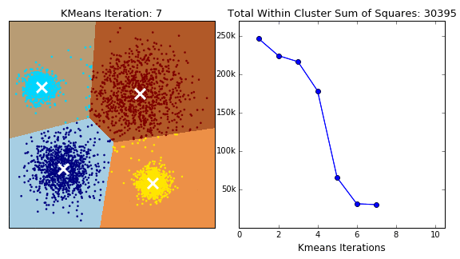
You try it
Time to write an explanation
Why is this dot assigned to the blue cluster?

Slide 19
You try it
This is a simulation of k-means clustering
Notes:
Gif from https://dashee87.github.io/data%20science/general/Clustering-with-Scikit-with-GIFs/

Slide 20
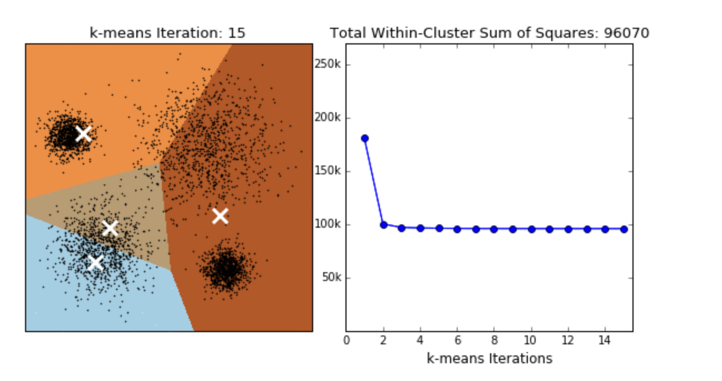
You try it
Time to write an explanation
Why is this dot assigned to the red cluster?

Slide 21
You try it
Time to write an explanation
Why is this dot NOT assigned to the blue cluster?

Slide 22
You try it
Time to write an explanation
When does clustering work well?

Slide 23
You try it
Time to write an explanation
How do you correct for bad predictions?

Slide 24
You try it
Time to write an explanation
How do you correct for bad predictions?

Slide 25
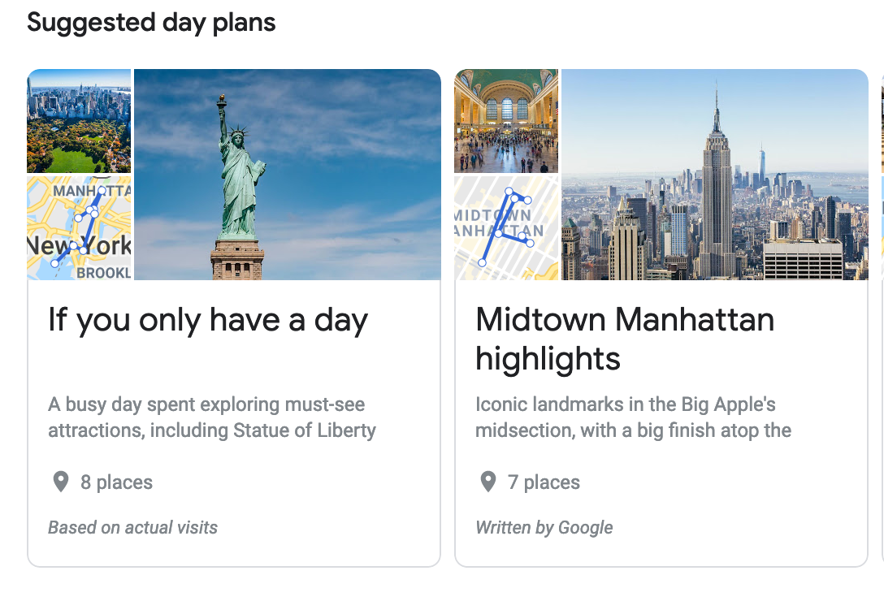
You try it
Time to write an explanation
What is the question this explanation answers?

Slide 26
What questions does this visualization answer?
Why did you do that?
Why not something else?
When do you succeed?
When do you fail?
When can I trust you?
How do I correct an error?
Notes:
From https://distill.pub/2018/building-blocks/

Slide 27
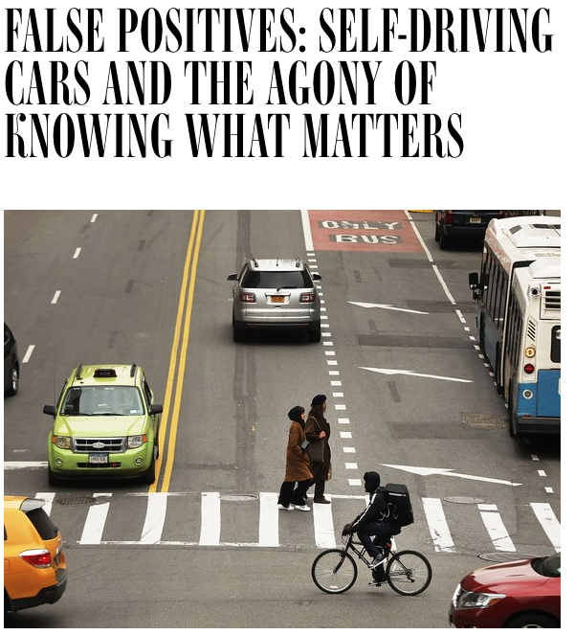
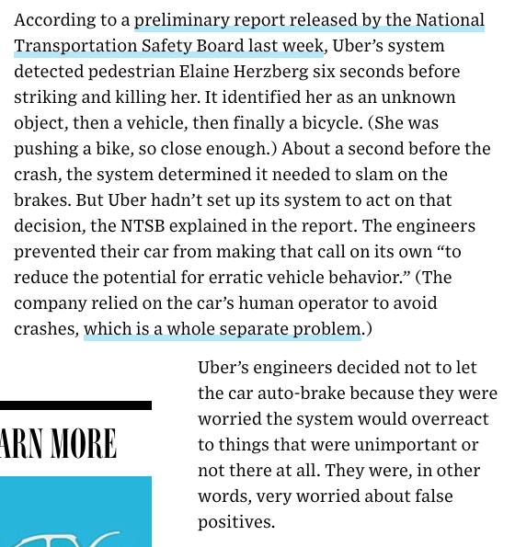
When should you give people an explanation?
https://www.wired.com/story/self-driving-cars-uber-crash-false-positive-negative/

Slide 28
Some more takeaways
Different explanations are useful for different questions
Can you just write an explanation without knowing the question?
How do you know what questions people have???
Can we always give people an explanation?

Slide 29


From Week 1: Start at the End …
Ask what the goals are for different stakeholders
What questions they may have
What answers we can give
What to do when you can’t give answers
Training Data (experience)
Machine Learning Algorithm
(task)
New Example
Model
??
Notes:
iteration, and not just on the model, or even the data, although both are important.
We need to iterate to find good problems.

Slide 30
One more thing: We need to design with the mind in mind
System 1 thinking Fast, automatic, frequent:
determine that an object is at a greater distance than another
complete the phrase "war and ..."
Takes work to override. Brains are lazy.
(if you can’t remember which is System 1 vs. System 2, I can’t either -- I google it every time)
System 2 thinking:
Slow, conscious, infrequent:
“Give me a minute to think about it”
Park in a tight parking spot
Write a note for a project extension
Takes effort. => people are unable to do it if: tired, sleep deprived, task is repetitive, etc.

Slide 31
On Thursday...
Are there principled approaches to creating explanations?
Are there trade-offs?
How does explanability intersect with accuracy and fairness?
Meanwhile, look for AI explanations in the products you use.

Slide 32
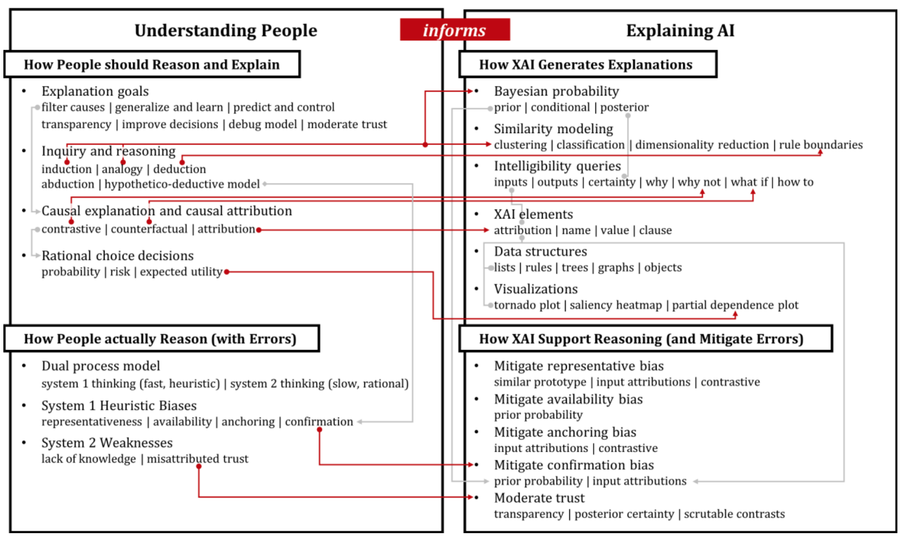
Notes:
http://www.brianlim.net/wordpress/wp-content/uploads/2019/01/chi2019-reasoned-xai-framework.pdf

Slide 33
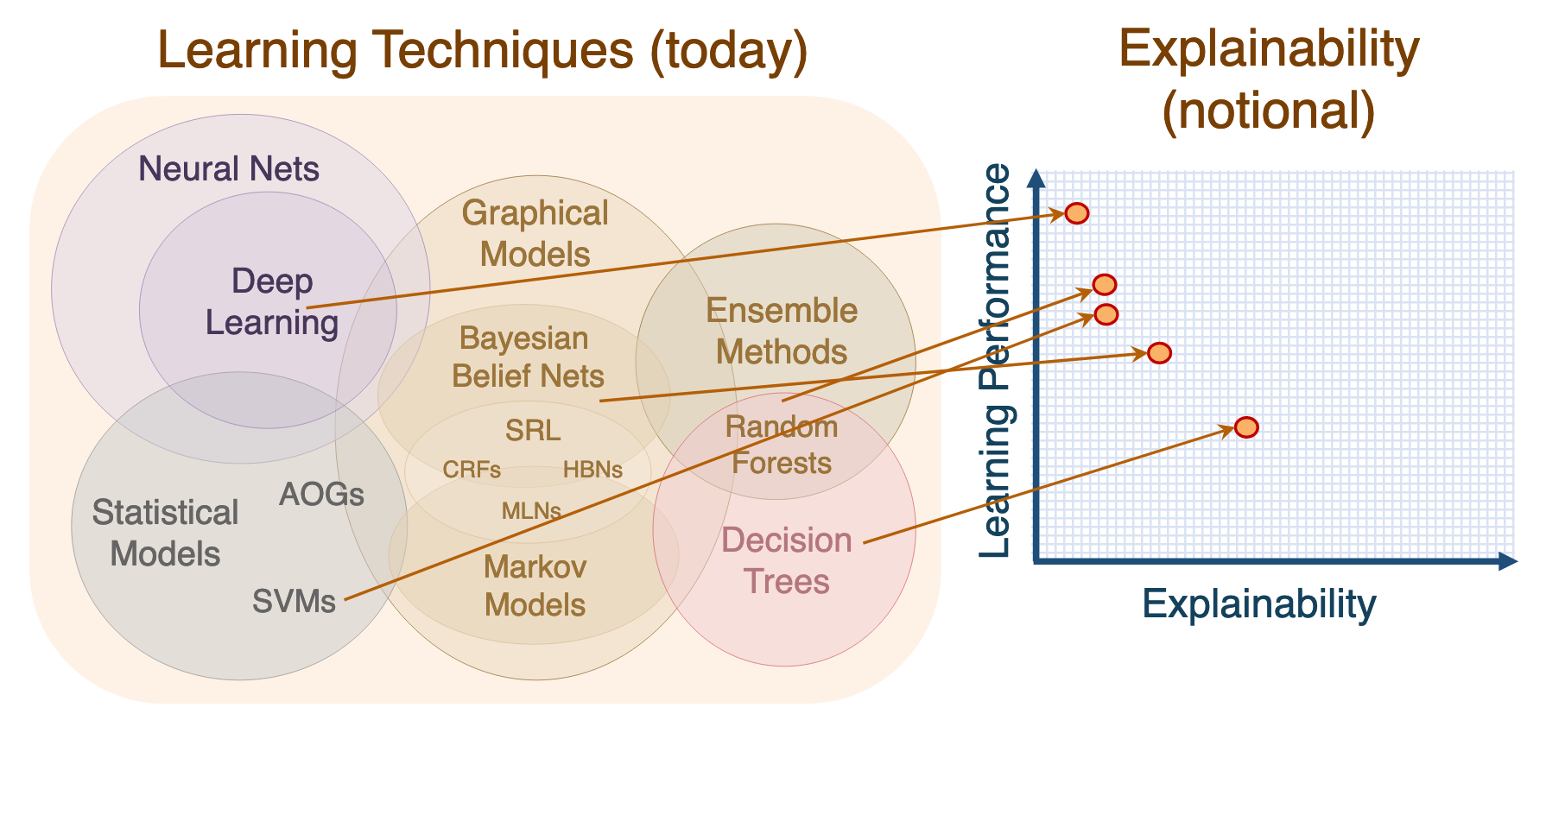
Notes:
https://www.darpa.mil/attachments/XAIProgramUpdate.pdf

